Slide 1

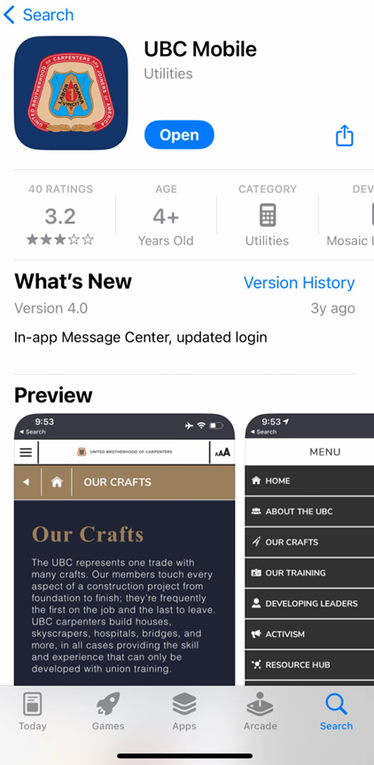
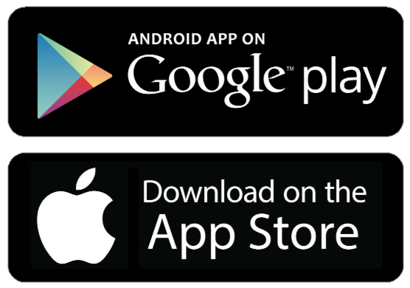
UBC Mobile Download
Go into your app store whether android or apple.
Search for UBC Mobile
Click Download or Open
Once completed, open the app

Slide 2
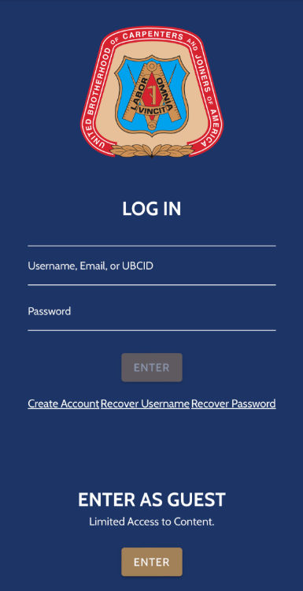
UBC Mobile Log in Screen
The email is going to be what is on file for the Council and Training center or use your UBC ID.
Your password would be your last 4 of social until you change it
If you have not created an account click here.
If you forgot your credentials then click here as well
Once this is complete then it will take you to the home screen

Slide 3
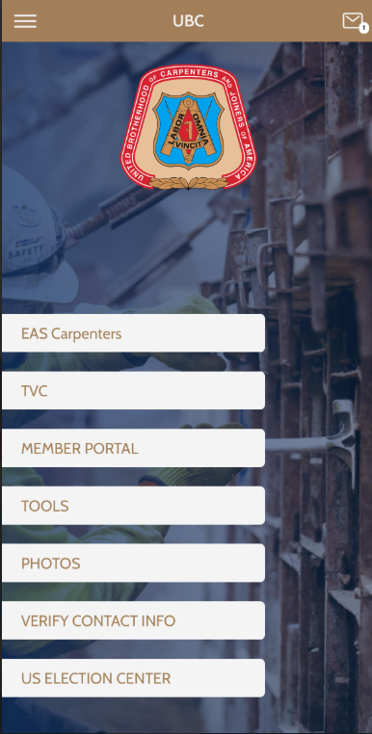
UBC Mobile Home Screen
On this screen you are able to access your TVC and Member portal.
If your screen does not look like this then you need to click at the top left where the there is 3 lines.
You will need to update this app interface and follow the prompts.

Slide 4
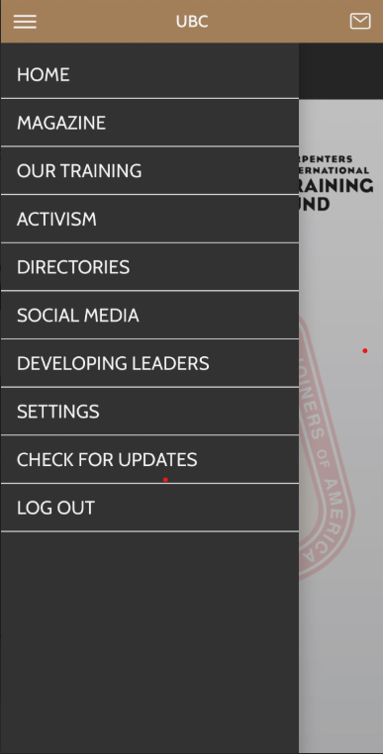
UBC Mobile App Updates
This is where you click to update your app to be able to access your members portal.
Once you have the current updates completed it will tell you that the system is up to date and you are good to go.

Slide 5
UBC Mobile Home Screen
On this screen you are able to access your TVC and Member portal.
Access you TVC card by clicking on TVC.
Once in you will be able to share with foreman or superintendents that need your records by scanning the QR code that comes up.

Slide 6
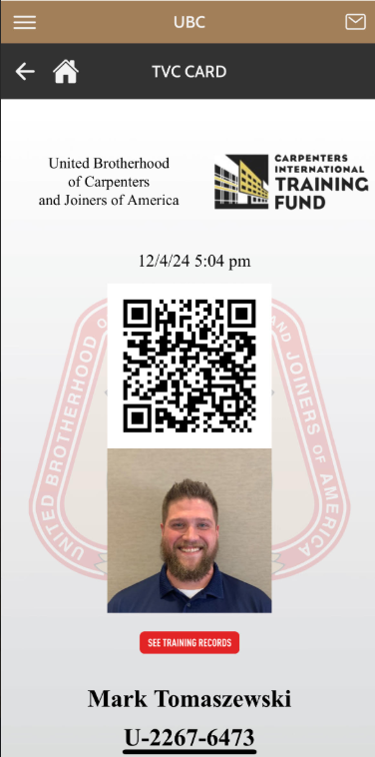
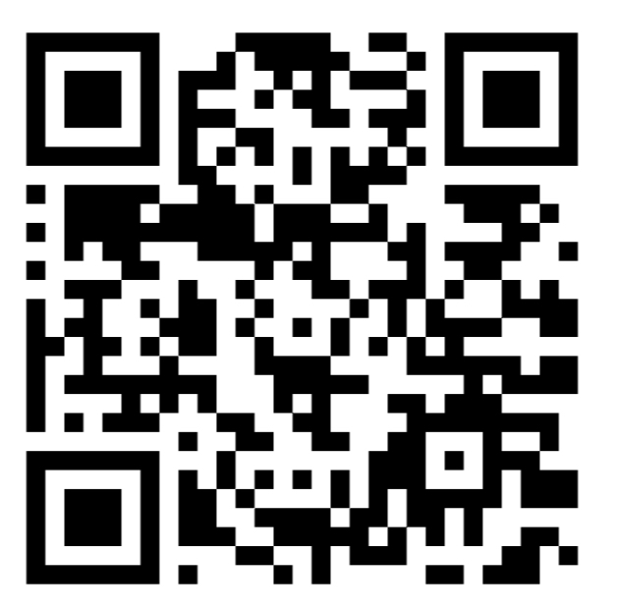
UBC Mobile TVC Home
This QR code will be the replacement of your hard card and will always be current with dues and trainings.
Your hard card will still be good. If you lose or damage it there will no longer be the physical card to get.
If you click where it says see training records it will bring you into the training records and paid through with your dues.

Slide 7
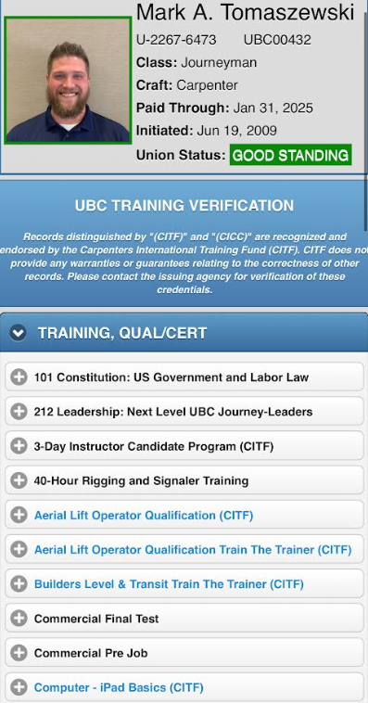
UBC Mobile Training Records
When the QR is scanned or when you click the See Training Records.
You are able to see if you are current or past due with your classes.
Also in the top section it will tell you where you stand in your dues where it says Paid Through

Slide 8
UBC Mobile Home Screen
On this screen you are able to access your TVC and Member portal.
Access your Members portal here

Slide 9
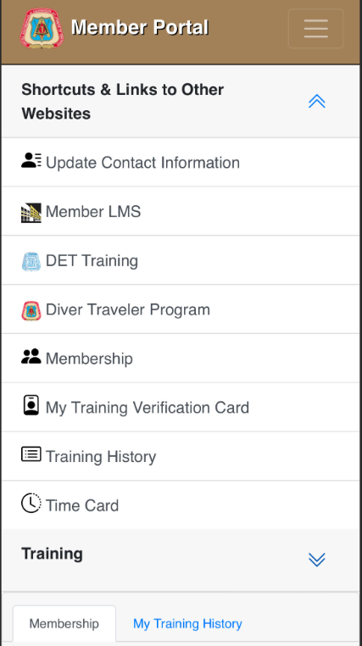
UBC Mobile Member Portal Home
Here is where you can access your dashboard for anything member wise.
All these are links for training and training history. You can complete your time card through here as well if you are an apprentice.

